Slide 1


Introduction to the chemistry of coordination compounds
Al-Farabi Kazakh National University
Faculty of Chemistry and Chemical technology
Department of General and Inorganic Chemistry
PhD Bakhadur Askar

Slide 2


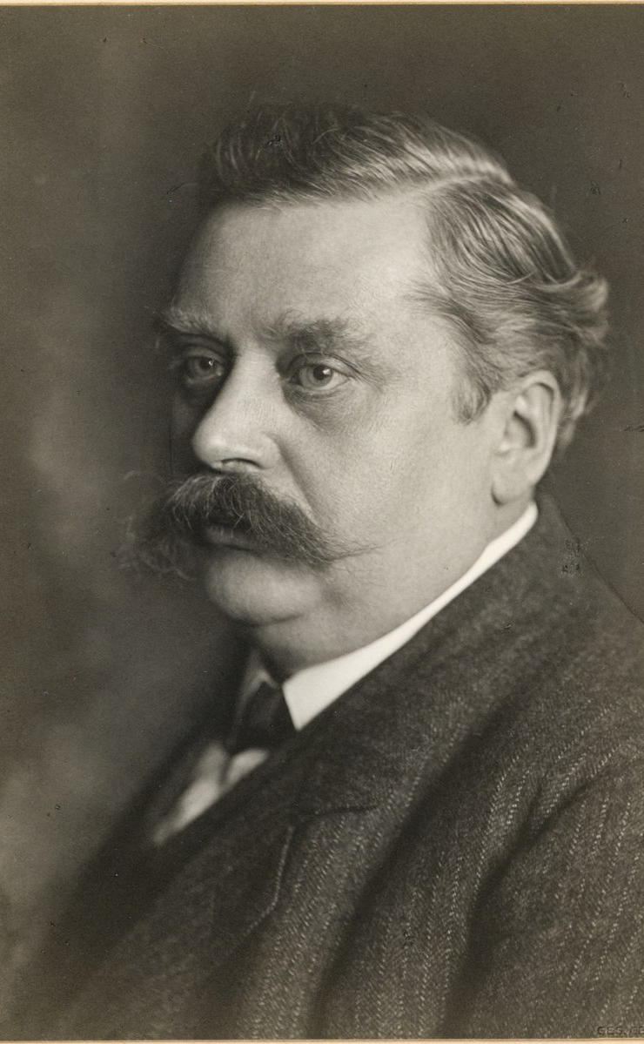


Historical background
The study of coordination compounds began in the 19th century with the work of Alfred Werner. Werner proposed the revolutionary idea that:
Metals can bond to molecules or ions (ligands) beyond their simple ionic valence.
Complexes possess definite geometries determined by the coordination number of the metal.
In 1893, Werner introduced the concept of coordination spheres, distinguishing between primary (ionic) and secondary (coordination) valences. For example:
$$\left[Co\left(NH_{3}{\left.)\right.}_{6}\right]Cl_{3}\right.$$
contains a cobalt(III) ion coordinated to six ammonia ligands, forming a stable octahedral complex.

Slide 3
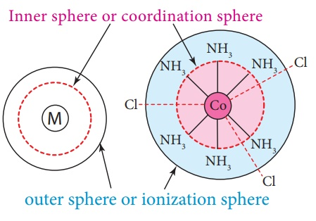

Basic concepts and definitions
A coordination compound consists of a central metal atom or ion surrounded by ligands, which donate electron pairs.
Central atom/ion: Usually a transition metal capable of accepting electron pairs.
Ligand: An ion or molecule that donates a lone pair to the metal (e.g., NH₃, Cl⁻, CN⁻, H₂O).
Coordination number (C.N.): The number of ligand donor atoms directly bonded to the metal.
Coordination sphere: The central metal plus its attached ligands, enclosed in brackets.
Example:
$$\left[Cu\left(NH_{3}{\left.)\right.}_{4}{\left.]\right.}^{2+}\text{ → }\text{C}\text{.}\text{N}\text{. = }\text{4}\text{, }\text{ligands}\text{ = }\text{NH}\text{₃}\right.\right.$$

Slide 4
Structure and bonding
Bond formation in complexes occurs through coordinate covalent bonds, where ligands donate electron pairs to the metal. Several bonding models explain this behavior:
1. Valence Bond Theory (VBT):
Bonding involves overlap between ligand orbitals and hybridized metal orbitals.
Predicts geometry and magnetic properties (e.g., sp³ = tetrahedral, d²sp³ = octahedral).
2. Crystal Field Theory (CFT):
Considers electrostatic interactions between metal ions and ligands.
Explains color, magnetism, and stability through d-orbital splitting.
3. Molecular Orbital Theory (MOT):
Provides a more accurate quantum mechanical description of bonding and electronic transitions.

Slide 5
Classification and nomenclature
Coordination compounds are classified based on:
Nature of the Ligand:
Neutral (NH₃, H₂O, CO), anionic (Cl⁻, CN⁻, OH⁻), or cationic (NO⁺).
Charge of the Complex:
Cationic ([Co(NH₃)₆]³⁺), anionic ([Fe(CN)₆]³⁻), or neutral ([Ni(CO)₄]).
Coordination Number and Geometry:
2 → Linear, 4 → Tetrahedral/Square planar, 6 → Octahedral.
Nomenclature Rules (IUPAC):
Ligands are named alphabetically before the metal.
Prefixes (di-, tri-, tetra-) indicate the number of ligands.
Metal oxidation state is given in Roman numerals. Example: [Cr(H₂O)₆]Cl₃ → hexaaquachromium(III) chloride.

Slide 6
Isomerism in coordination compounds
Coordination compounds often exhibit isomerism, where compounds have the same composition but different arrangements.
Types of Isomerism:
Structural Isomerism:
Ionization isomerism: [Co(NH₃)₅Br]SO₄ ↔ [Co(NH₃)₅SO₄]Br
Coordination isomerism: Occurs when ligands exchange between two metal centers.
Stereoisomerism:
Geometrical (cis/trans): [Pt(NH₃)₂Cl₂] → cis & trans forms.
Optical: Non-superimposable mirror images (e.g., [Co(en)₃]³⁺).
Isomerism influences reactivity, color, and biological activity of complexes.

Slide 7

Stability and chemical equilibrium
The stability of coordination compounds depends on metal–ligand interactions and solution equilibria.
Two types of stability:
Thermodynamic stability: Related to the formation constant (Kf), indicating how readily a complex forms.
$$M^{2+}+6NH_{3}⇌\left[M\left(NH_{3}{\left.)\right.}_{6}{\left.]\right.}^{2+}\right.\right.$$
High Kf → stable complex.
Kinetic stability: Describes rate of ligand substitution. For example:
[Co(NH₃)₆]³⁺ is kinetically inert.
[Ni(H₂O)₆]²⁺ is labile (ligand exchange occurs rapidly).
Factors affecting stability include metal charge density, ligand basicity, chelation, and pH.

Slide 8
Summary
Coordination compounds consist of a metal center bonded to ligands through coordinate covalent bonds.
Theories such as VBT, CFT, and MOT explain their bonding, geometry, and color.
Nomenclature follows systematic IUPAC rules based on ligand type and oxidation state.
Isomerism (structural and stereochemical) affects their chemical and physical behavior.
Stability depends on both thermodynamic and kinetic factors, governed by equilibrium constants.
Applications extend across medicine, catalysis, biology, and materials chemistry.

Slide 9
Thank you for attention!

